Slide 1
Unsupervised Learning
UIUC ECON 490: Applied Machine Learning in Economics

Slide 2
Labels ($y$) supervise the data
From HoML:
The computer scientist Yann LeCun famously said that “if intelligence was a cake, unsupervised learning would be the cake [and] supervised learning would be the icing on the cake…”
Tasks/Questions you can ask with unsupervised learning:
Clustering
Market segmentation
Common trends
Anomaly detection - sklearn
Credit card fraud
New time series trends

Slide 3
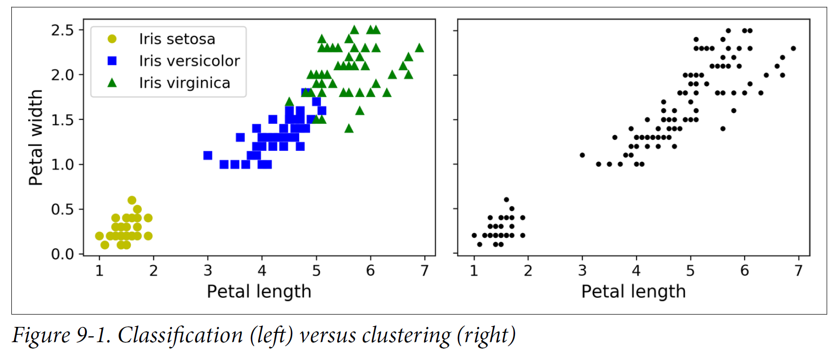
Classification vs. Clustering

Slide 4
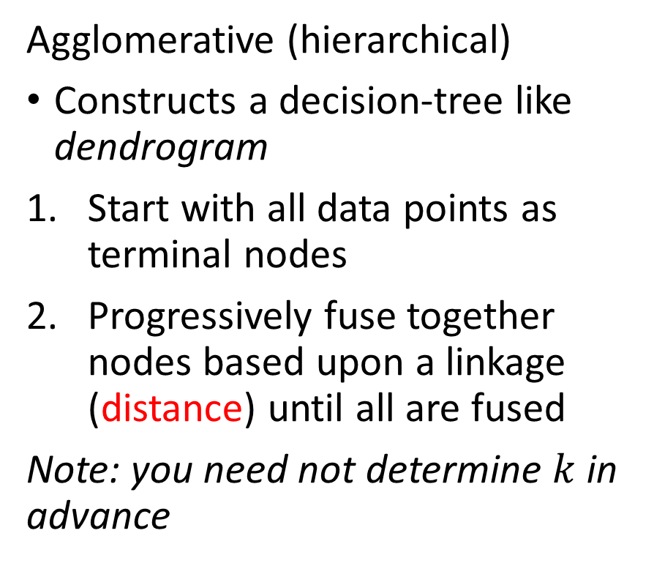
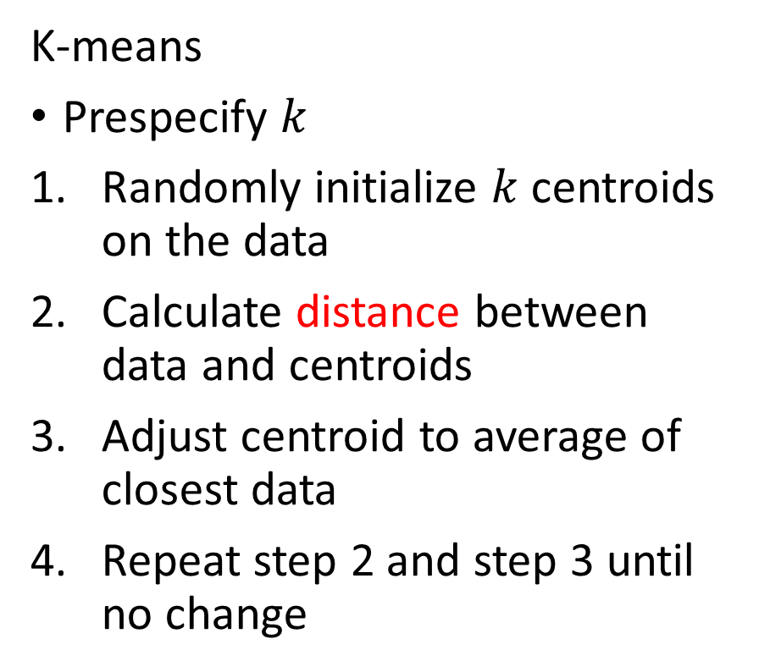
Two algorithms: K-means & Agglomerative
K-means
Prespecify $k$
Randomly initialize $k$ centroids on the data
Calculate distance between data and centroids
Adjust centroid to average of closest data
Repeat step 2 and step 3 until no change
Agglomerative (hierarchical)
Constructs a decision-tree like dendrogram
Start with all data points as terminal nodes
Progressively fuse together nodes based upon a linkage (distance) until all are fused
Note: you need not determine $k$ in advance

Slide 5
Clustering uses distances
Standardize the data

Slide 6
K-Means Clustering
A simple algorithm

Slide 7
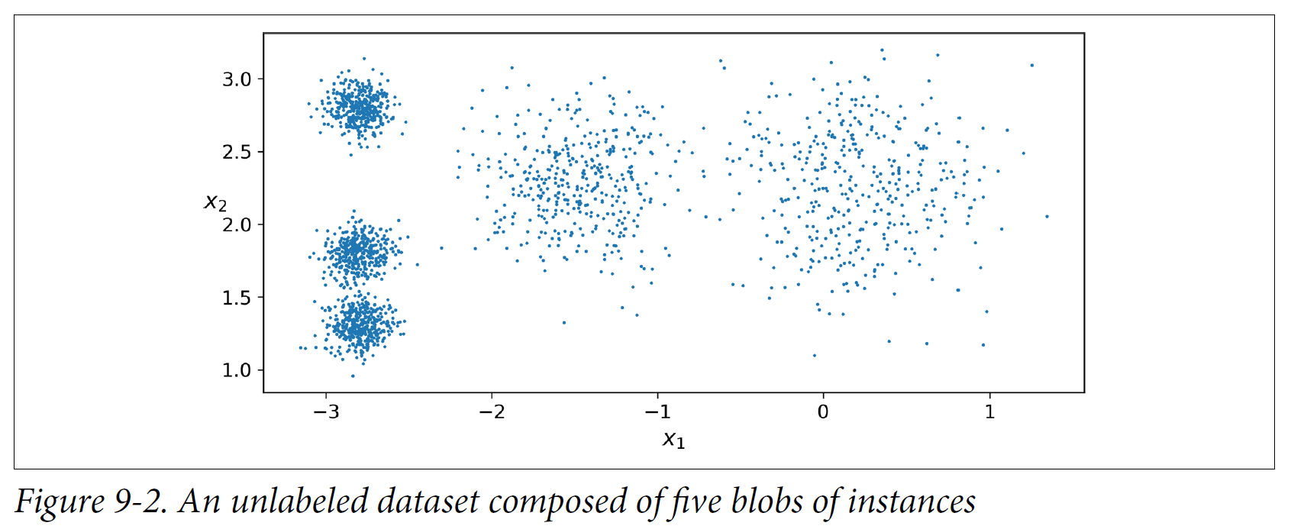
Real data are typically not this nice (# features, etc.)

Slide 8
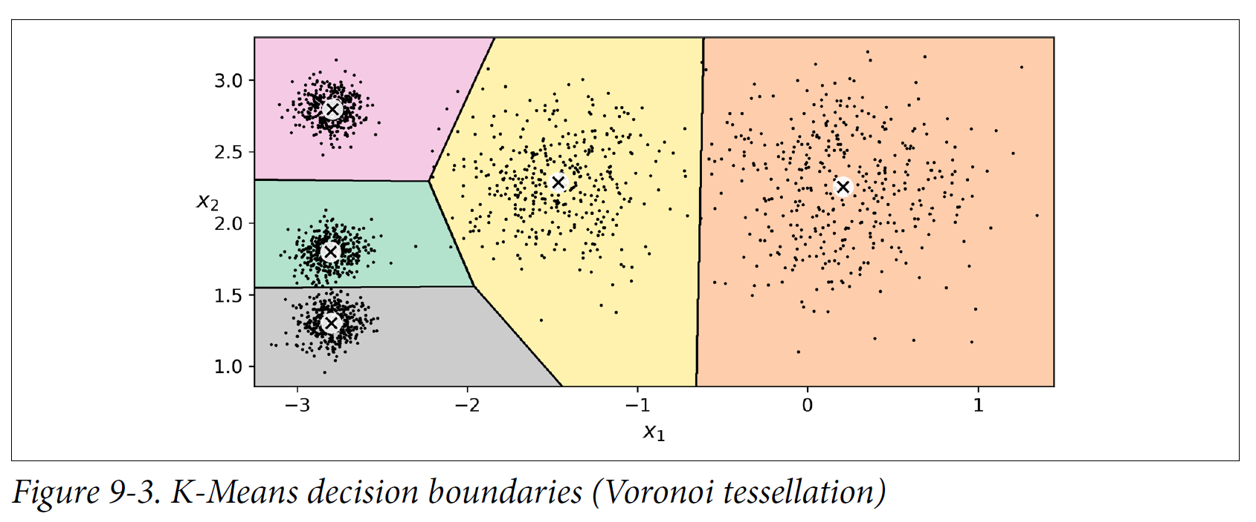
How K-Means clusters these data

Slide 9
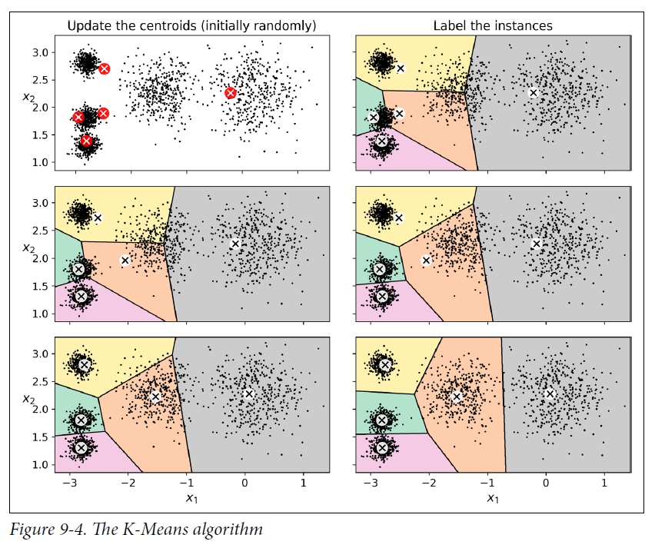
Three iteration convergence on these data

Slide 10
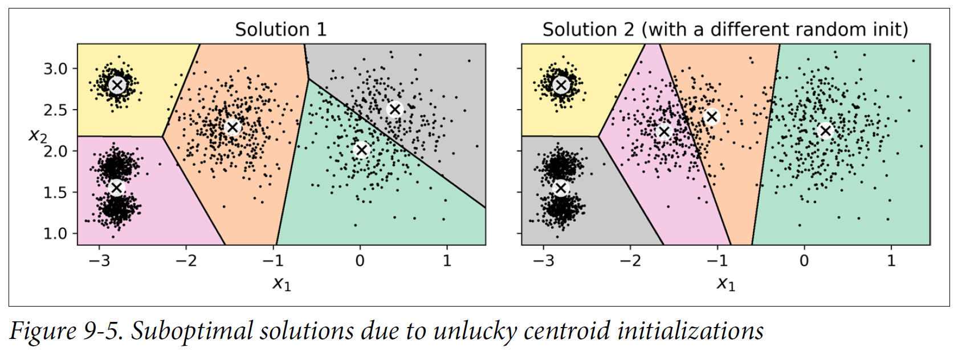
K-Means is sensitive to initialization (local minima)

Slide 11
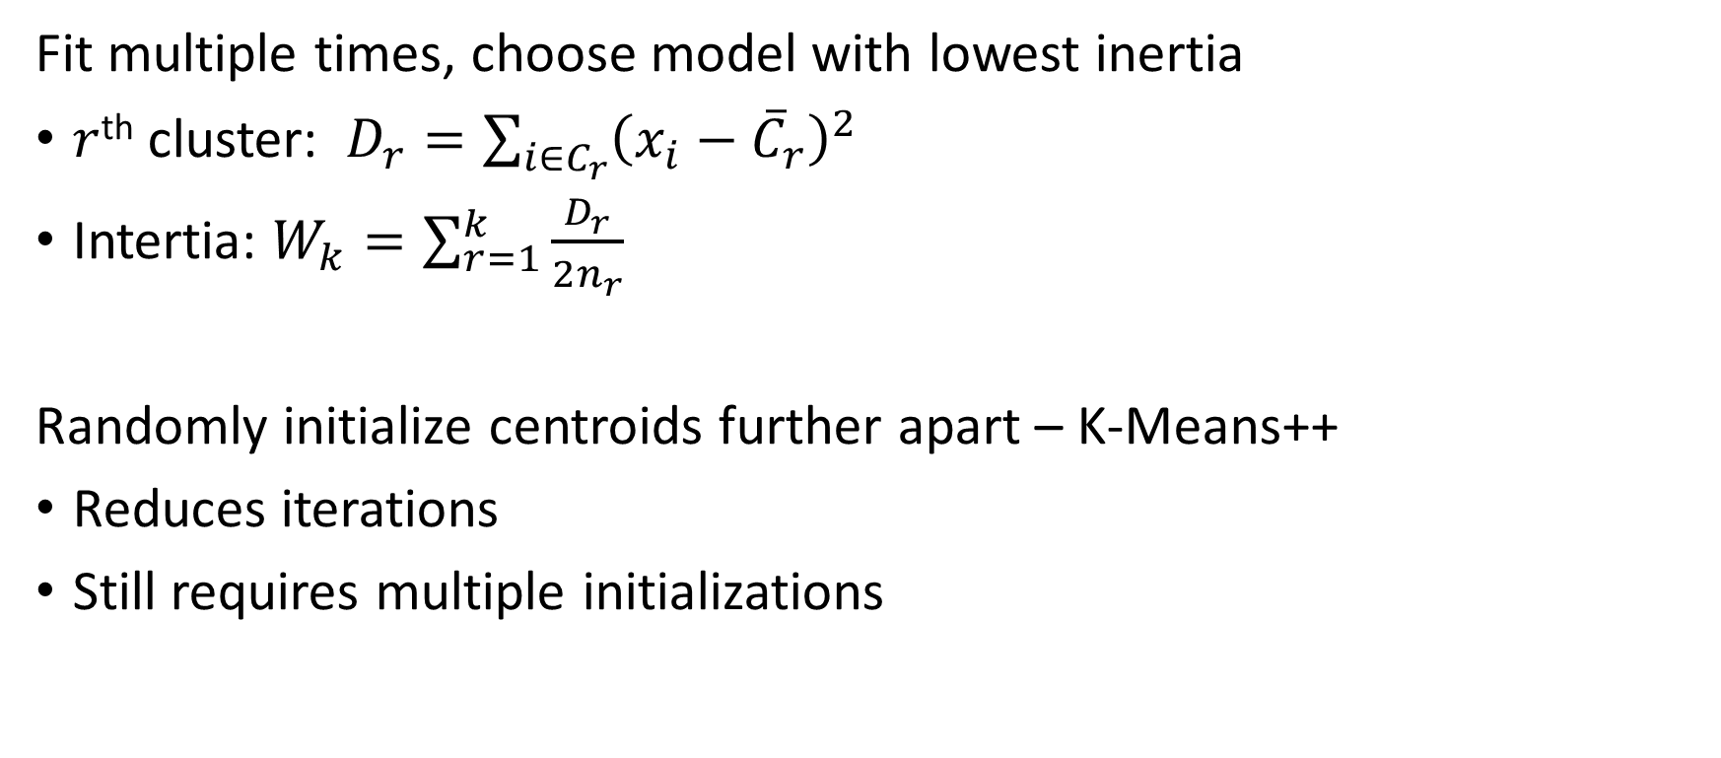
Brute force solutions to initialization sensitivity
Fit multiple times, choose model with lowest inertia
$r$^{th} cluster: $D_{r}=\sum_{i∈C_{r}}{{\left(x_{i}−{\overline{C}}_{r}\right)}^{2}}$
Intertia: $W_{k}=\sum_{r=1}^{k}{\frac{D_{r}}{2n_{r}}}$
Randomly initialize centroids further apart – K-Means++
Reduces iterations
Still requires multiple initializations

Slide 12
Scitkit-learn
sklearn.cluster.KMeans()
n_clusters – default 8
n_init – number of random starts, default 10
max_iter – maximum cluster iterations per initialization, default 300
random_state

Slide 13
Agglomerative Clustering
Tree-like dendrograms

Slide 14
Agglomerative clustering fuses data by linkages
Linkages
Ward – fuse two “clusters” that produces the smallest variance
Average – computer average pairwise distances in cluster
Fuse two clusters that produce the new smallest average pairwise distance
Complete – like average, but maximum of pairwise distances
Single – like average, but minimum
Can result in trailing dendrograms

Slide 15
Following images are on these data with n_cluster=5

Slide 16
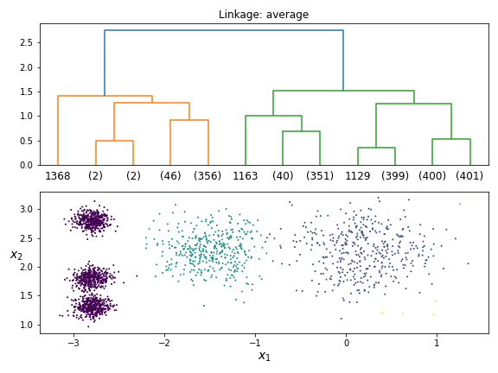
My choice of clusters from Average: 2-6?

Slide 17
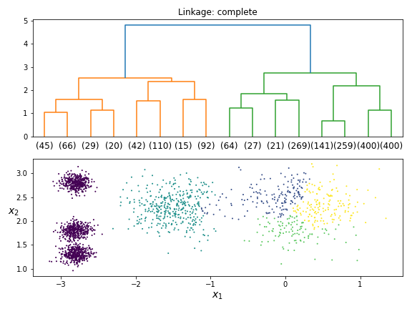
Complete: 5-6

Slide 18
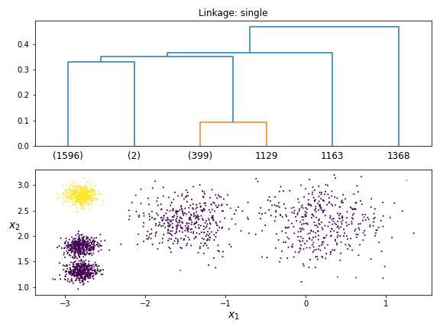
Single: ?

Slide 19
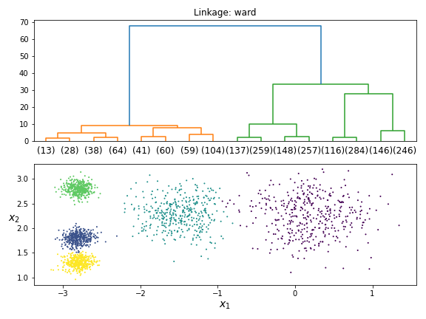
Ward: 4

Slide 20
Fit: Scikit-learn, plot: scipy
sklearn.cluster.AgglomerativeClustering()
n_clusters – default 8
compute_full_tree – Boolean
linkage – default “ward”
compute_distances – default False
scipy.cluster.hierarchy.dendrogram()
truncate_mode – default None, you want “level”
p – default 30, depth of truncation, 3-5 is fine. Prior figures use 3.
See “Lecture 23 Figures.ipynb” for an example

Slide 21
sklearn.cluster
Many algorithms

Slide 22
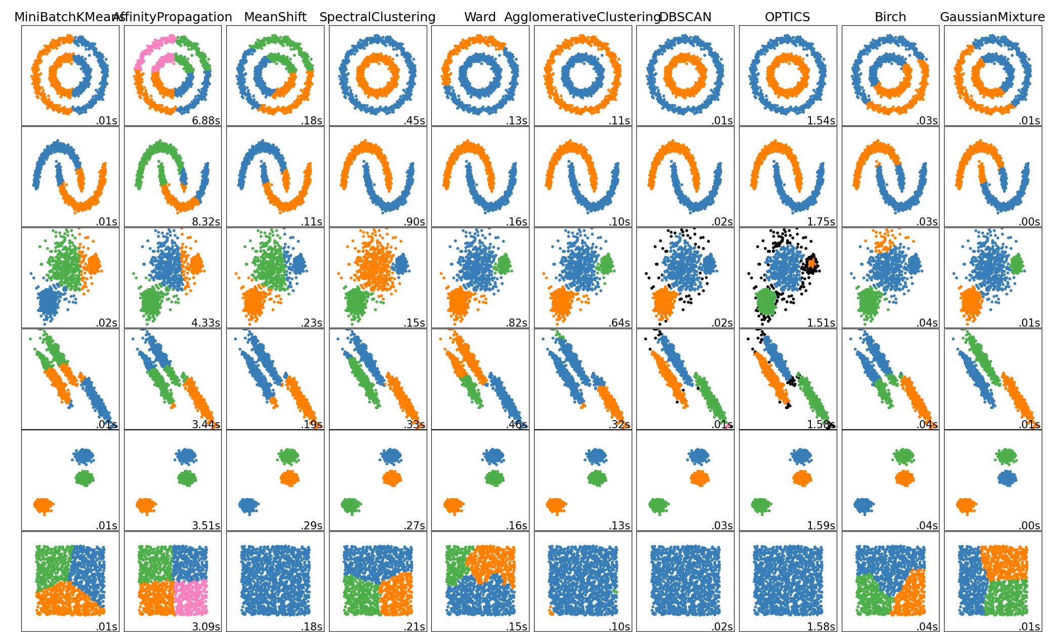
There are many clustering algorithms

Slide 23
Main Takeaways
Most of the data in the real world is unsupervised
The “true” number of clusters may be unknowable depending on data
We will discuss some techniques next time
K-Means and Agglomerative are slow with large data
Requires calculating distance matrices
We will discuss some techniques next time

